Slide 1


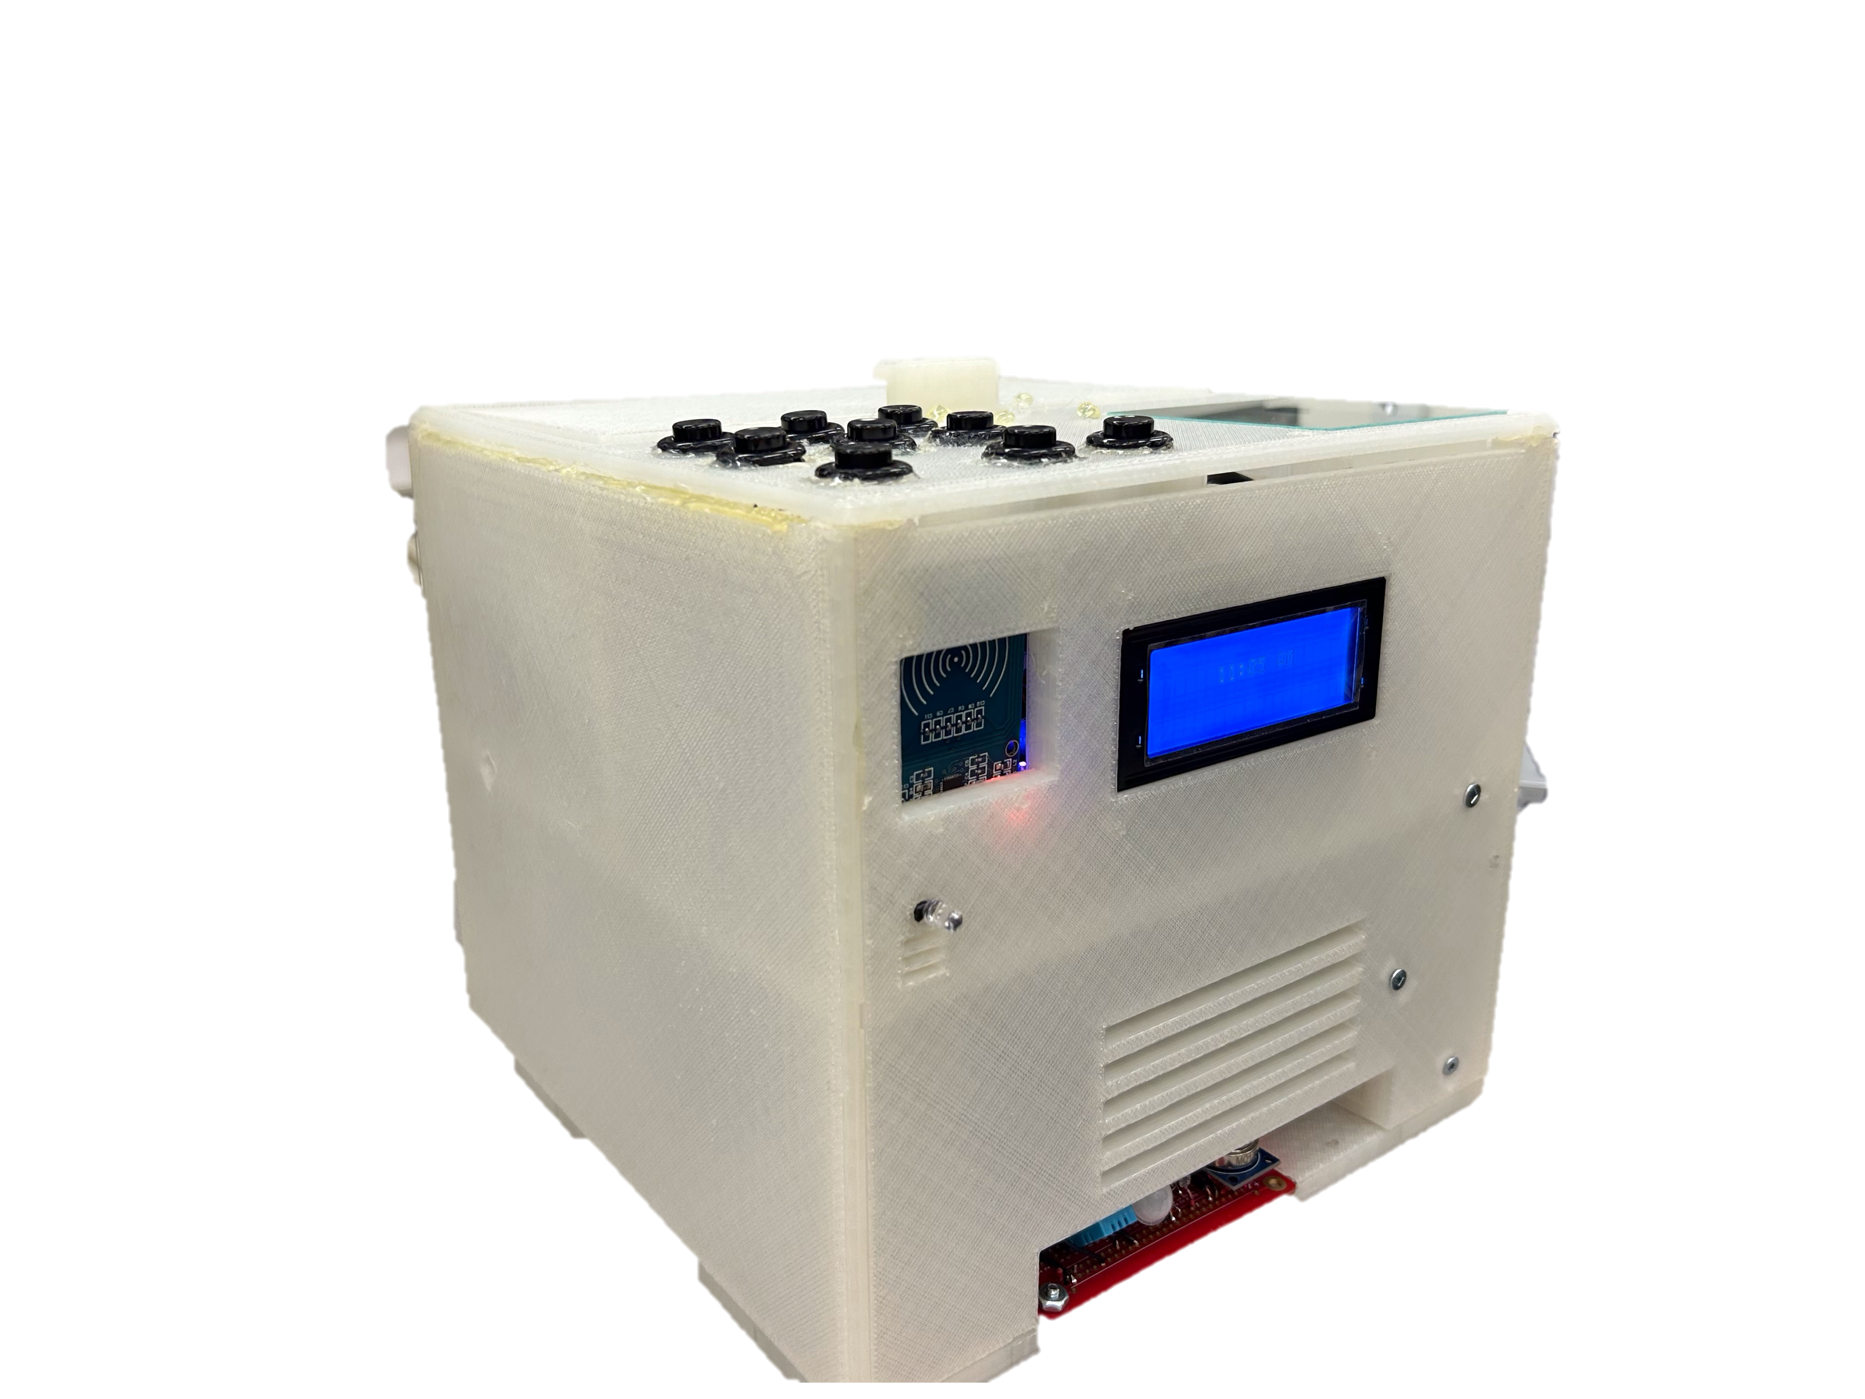
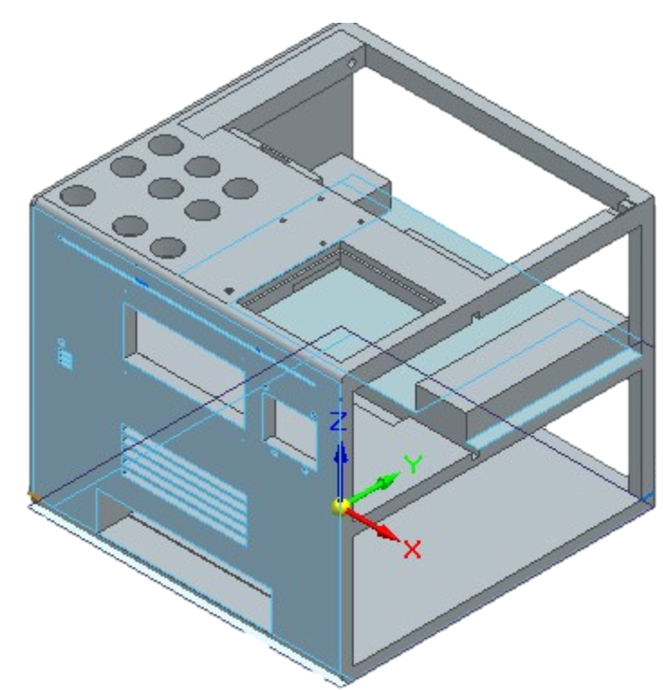
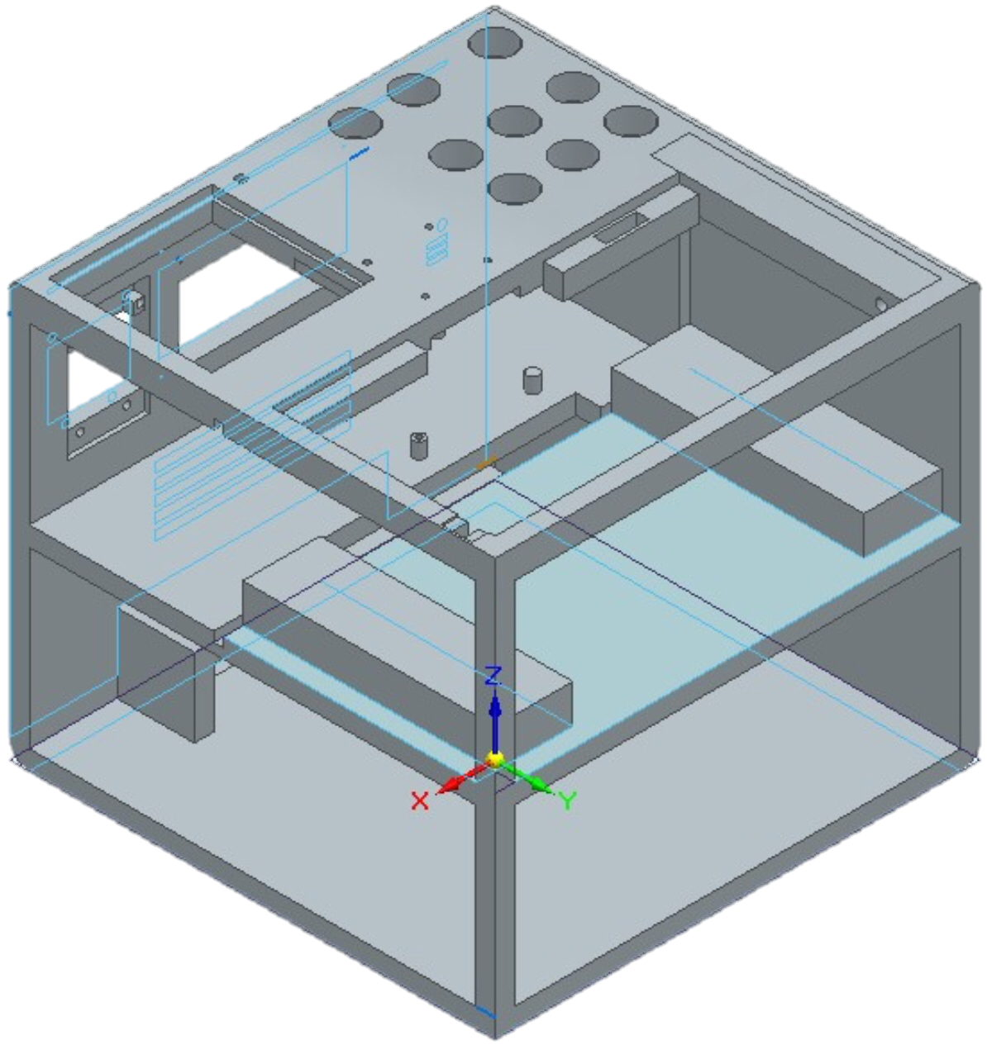
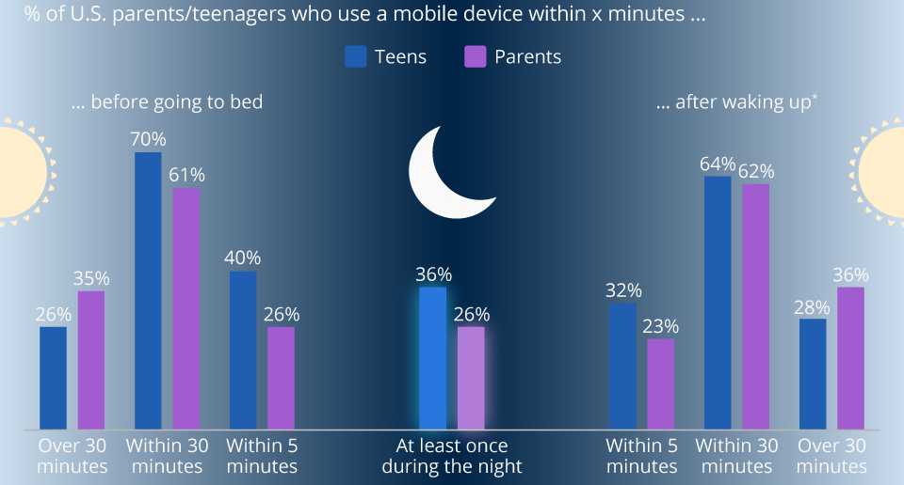


Well-Phone
Benefits
Delayed Gratification
Develop Positive Behaviors
Builds Healthy Habits into Adulthood
Recognize Feelings
Improves Physical Health
Better Sleep Quality
Introduction
We aimed to improve long term quality of life through a consistent positive reward based system for children, by removing their phones before bed.
This system consists of research proven activities that focus on the users physical, mental, and emotional wellbeing. This provides an interactive and engaging way to establish healthy habits for a lifetime.
Smartphone Lockbox
Next Steps
Turning the Well-Phone into a usable tool for children by:
Creating app that controls Well-Phone Lockbox.
List activities/goals to set on app
Make rewards list that displays current streak and points to claim reward.
Features
Alarm Clock
Wireless Charging
UV Cleaning
Sleep Environment Sensor
Built-In AI Assistant
Physical, Mental and Emotional Activity Prompts
Automatic Locking Mechanism
EmotionMirror App Integration
References
Richter, F. (2019, May 31). Infographic: America's favorite bedside companion? Statista Infographics. Retrieved March 20, 2023, from https://www.statista.com/chart/12017/smartphone-use-in-the-morning-and-at-night/
UR courses: Log in to the site. (n.d.). Retrieved March 21, 2023, from https://urcourses.uregina.ca/mod/page/view.php?id=1971431
Visual identity. University of Regina. (n.d.). Retrieved March 20, 2023, from https://www.uregina.ca/communications-marketing/visual-identity.html#fact_15_5
Curtis Ficor, Sharmarke Hassan, Jadon Donais

